Slide 1
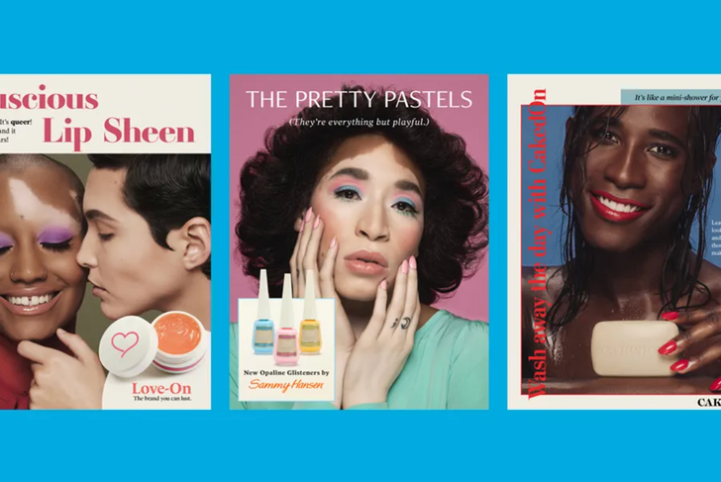




OPTIMIZING BEAUTY ADS
Maximizing Ad Performance through Audience Insights
Notes:
My name is Shem. Im one of the Team Leads for this project where we are focusing on marketing in the beauty space. We more specifically focused on the optimization on beauty ads and how to maximize ad performance.

Slide 2


Agenda
1 | Executive Summary
2 | Business Overview
3 | Inventory Analysis
4 | Audience Analysis
5 | Spatial Analysis
6 | Creative Analysis
7 | Recommendations
8 | Conclusion
2

Slide 3
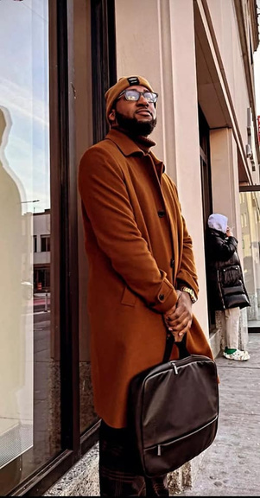
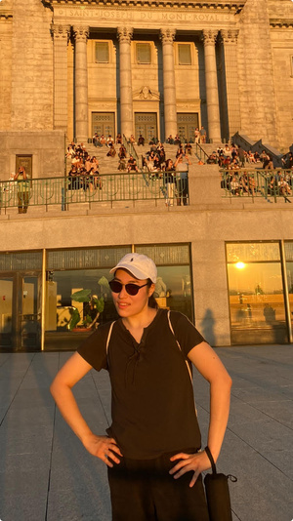
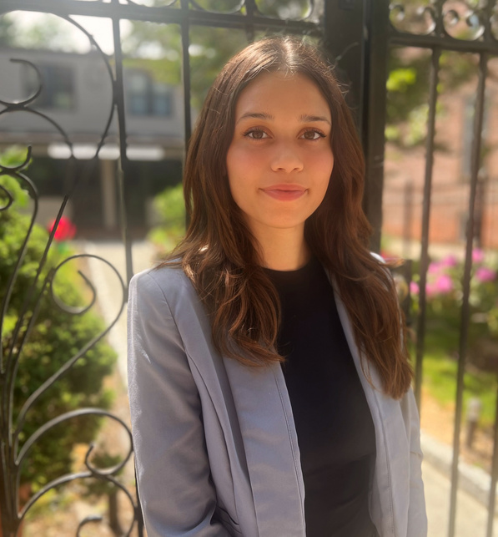
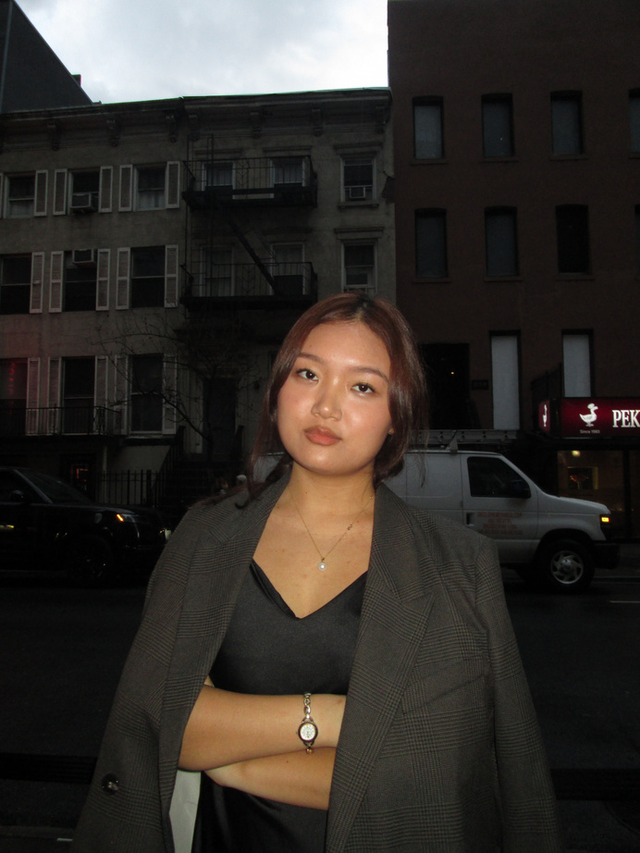
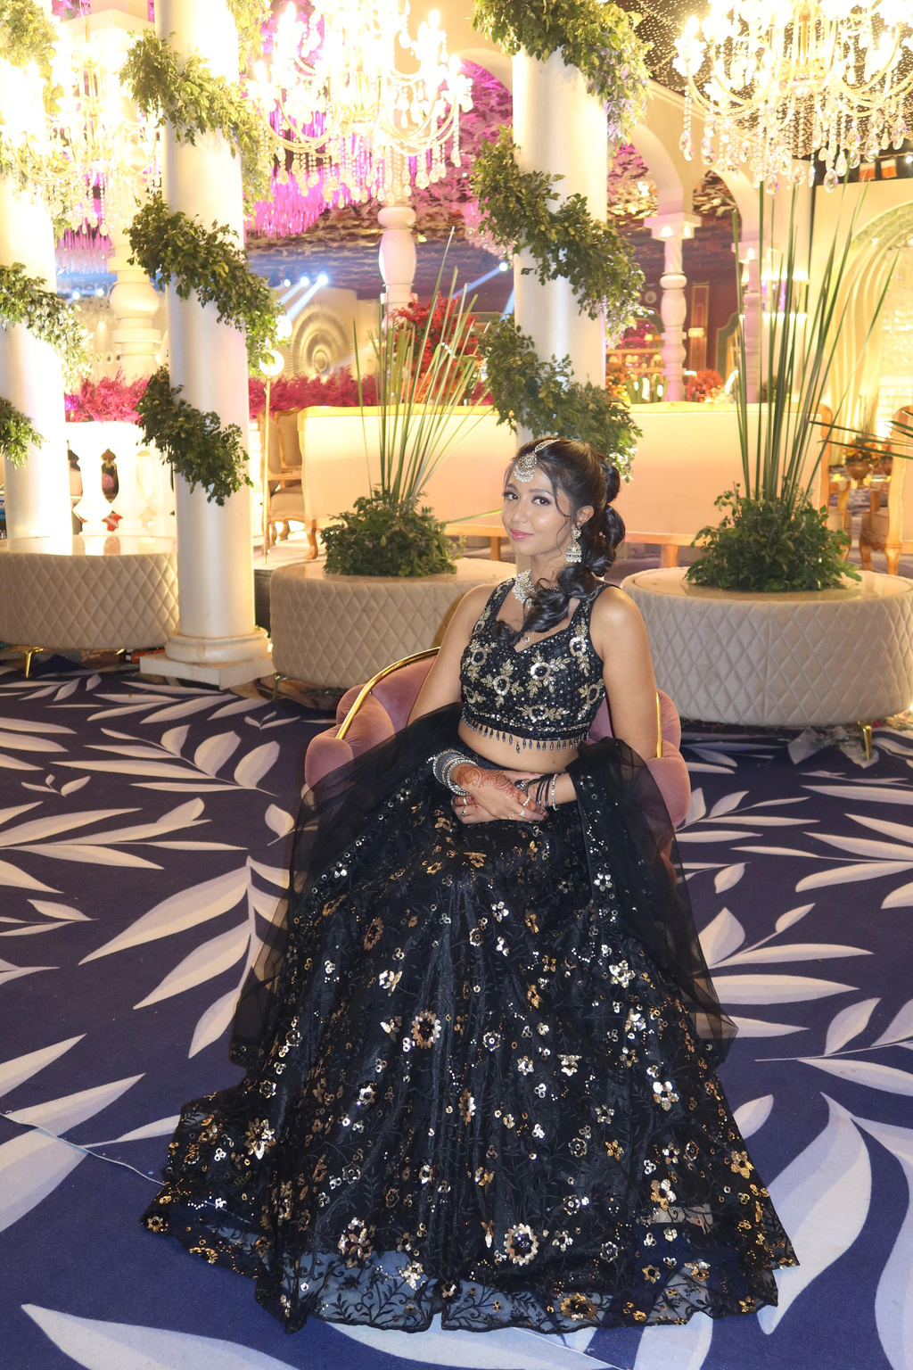
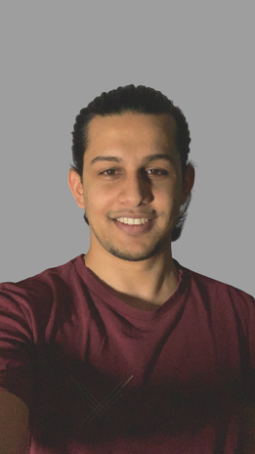
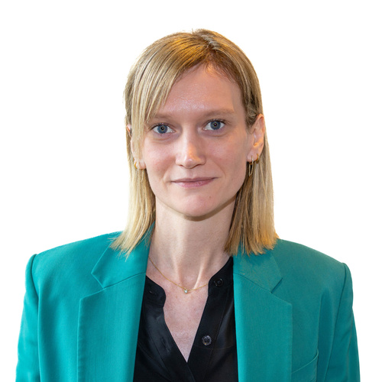

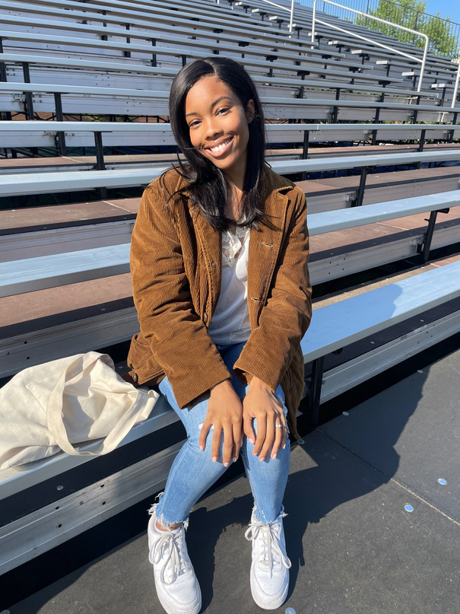
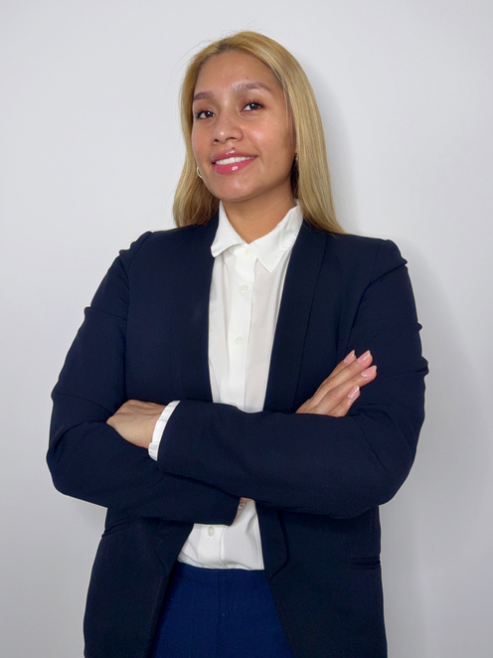
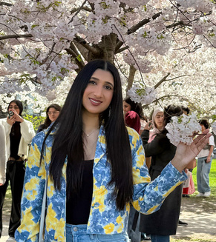
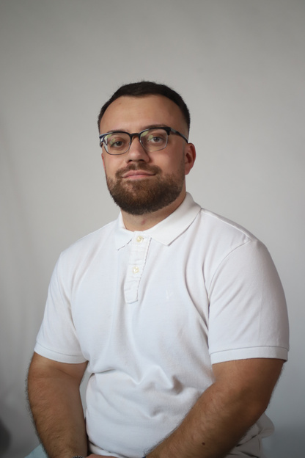
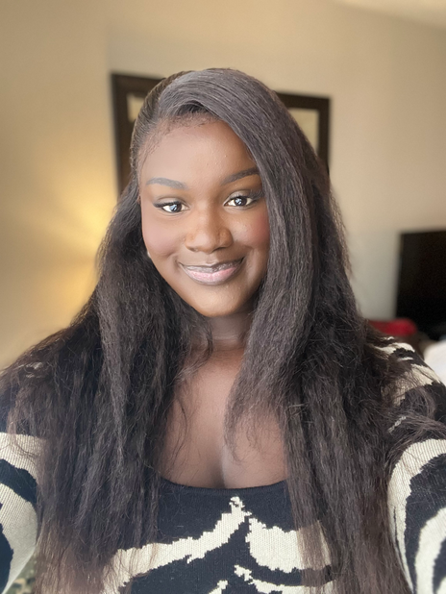
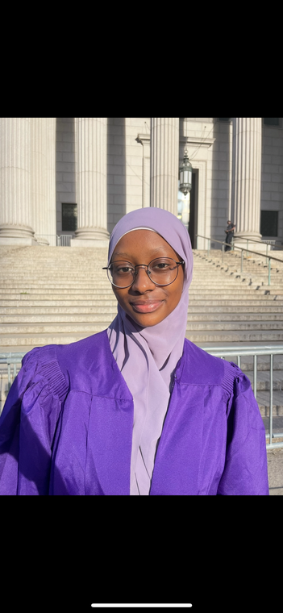
Meet The Team!
Shem Cumberbatch
Team Lead
Audience Analyst
Eunice Han
Audience Analyst
Eliza Gonzalez
Audience Analyst
Tenzin Nyima Inventory Analyst
Gurvinder Kaur
Inventory Analyst
Mohammad Mahmud
Inventory Analyst
Anastassia Troitskaia
Spatial Analyst
Bahauddin Naseer
Spatial Analyst
Ada Umeugo
Spatial Analyst
Mariely Mena
Spatial Analyst
Iqra Jan
Team Lead
Creative Analyst
Taulant Bega
Creative Analyst
Dimbe Fall
Creative Analyst
Oumarsodo Baro
Creative Analyst
3
Notes:
This is our team. I am going to pass it along to my fellow team Lead, Iqra

Slide 4
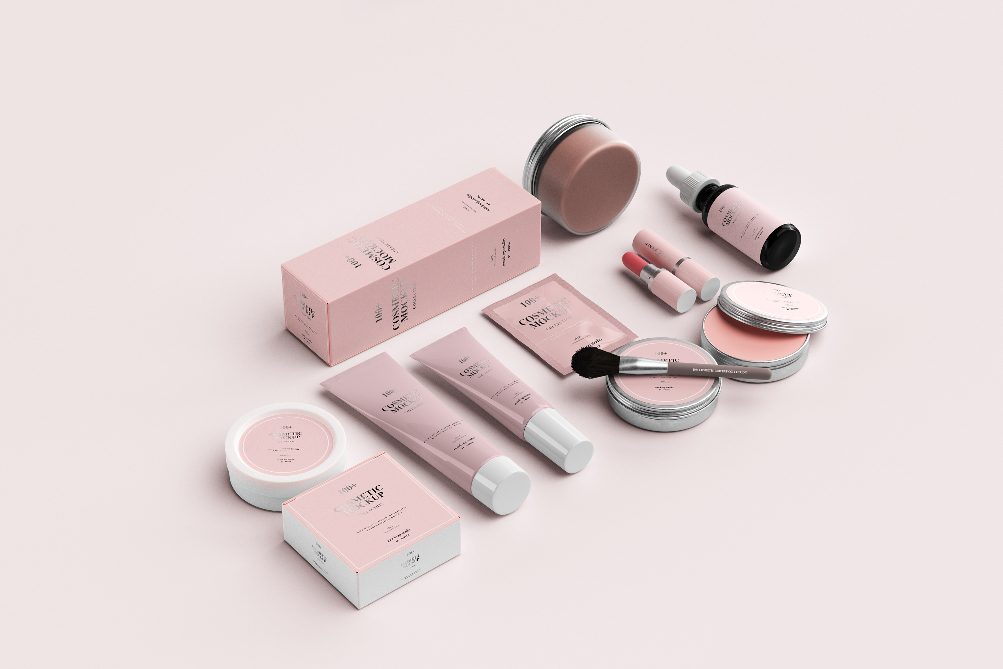
Executive Summary
The global beauty industry is one of the most dynamic and competitive consumer markets, projected to exceed $580 billion by 2027.
With rapid innovation, evolving consumer preferences, and an increasingly digital-first audience, advertisers face growing pressure to differentiate their campaigns and connect meaningfully with consumers.
As your global advertising agency seeks to refine its approach to the beauty sector, it is critical to understand which market segments, geographies, and creative strategies drive the highest engagement and return on investment.
This analysis leverages comprehensive data to uncover actionable insights that can help the agency sharpen its targeting strategy, boost ad performance, and maximize revenue across the beauty industry.
4
Notes:
READ BELOW
- The global beauty and personal care industry market cap for 2025 is 677 billion. Expected to grow 6.64% by 2032. According to Fortune Business Insights
- company budget 55 million
- expected to increase 30% by 2027

Slide 5
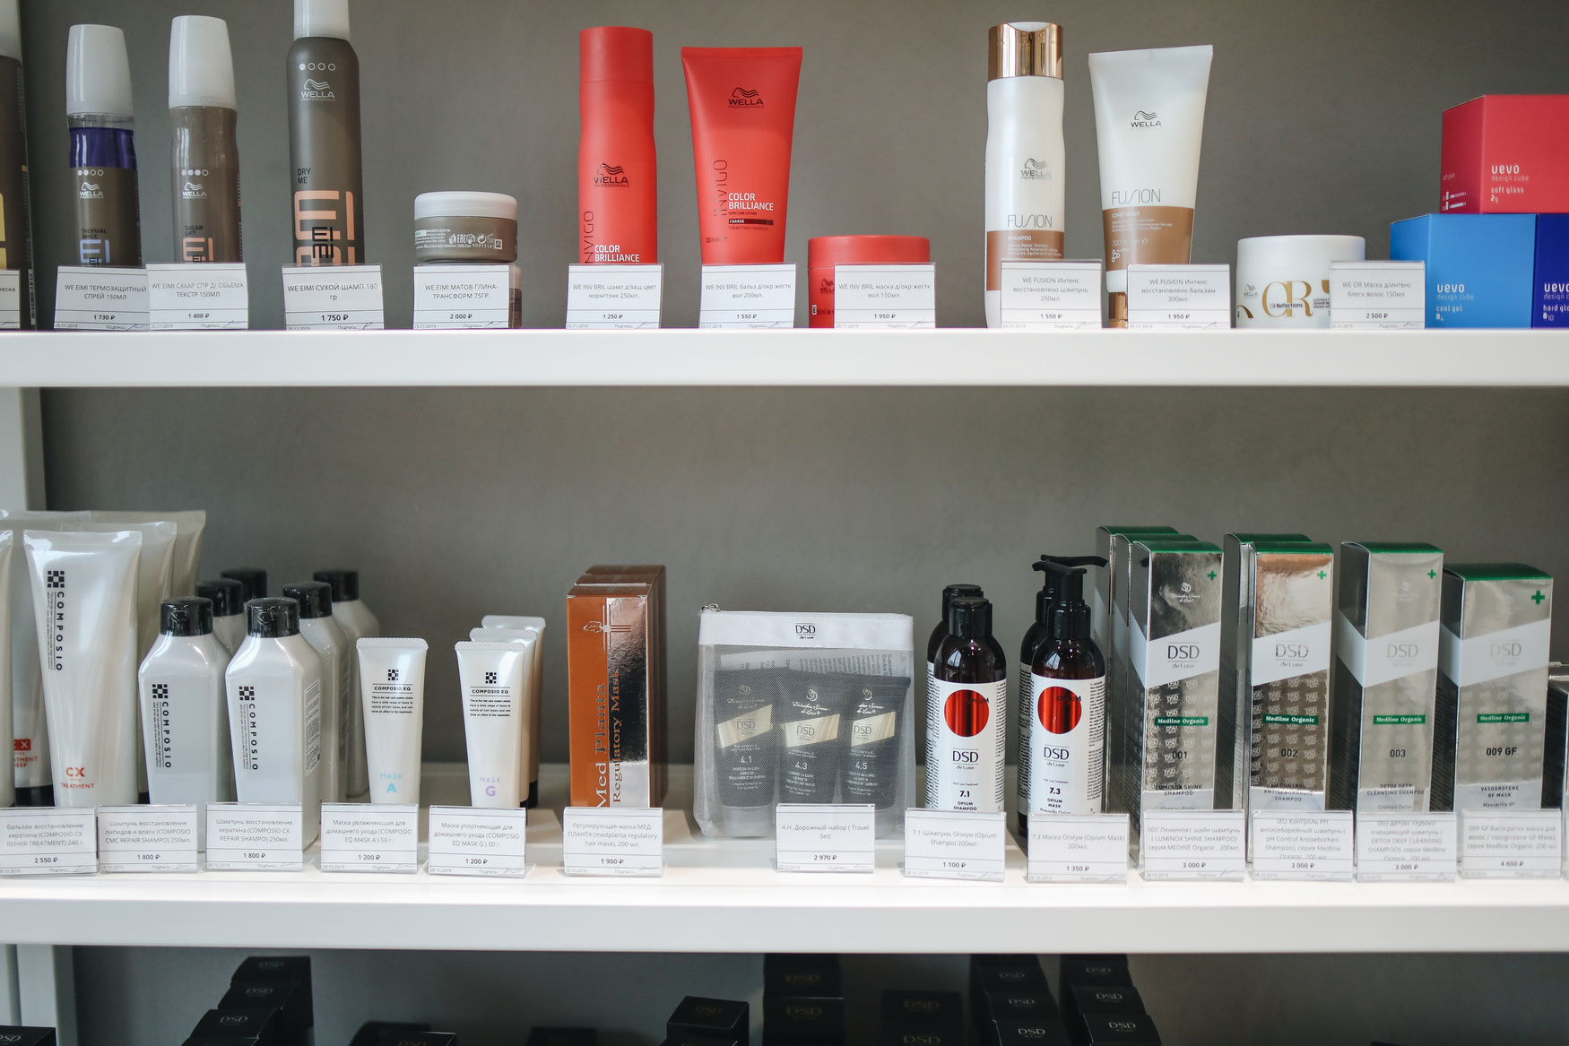
Business Overview
What are the most effective ways to reach and engage beauty consumers
in order to maximize advertising performance and revenue?
5

Slide 6

Understanding the Beauty Consumer: Why This Industry & Who We're Targeting
6

Slide 7
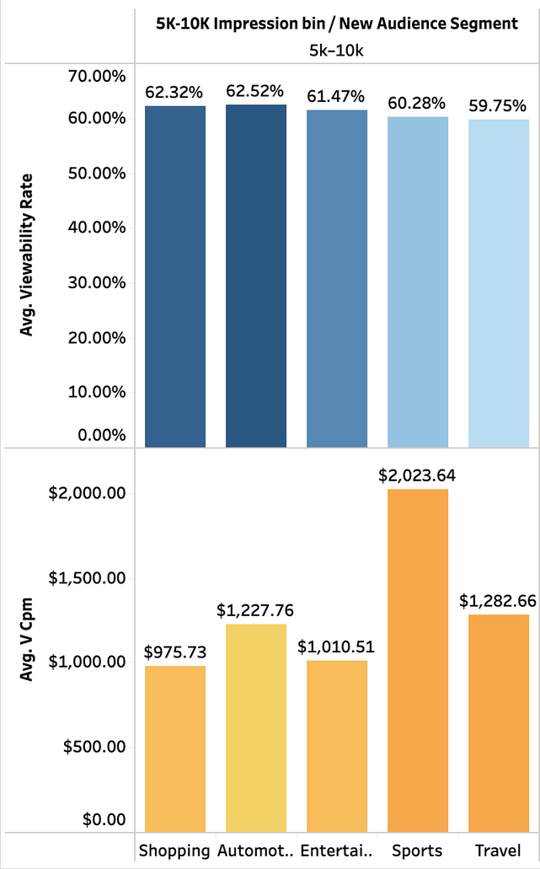
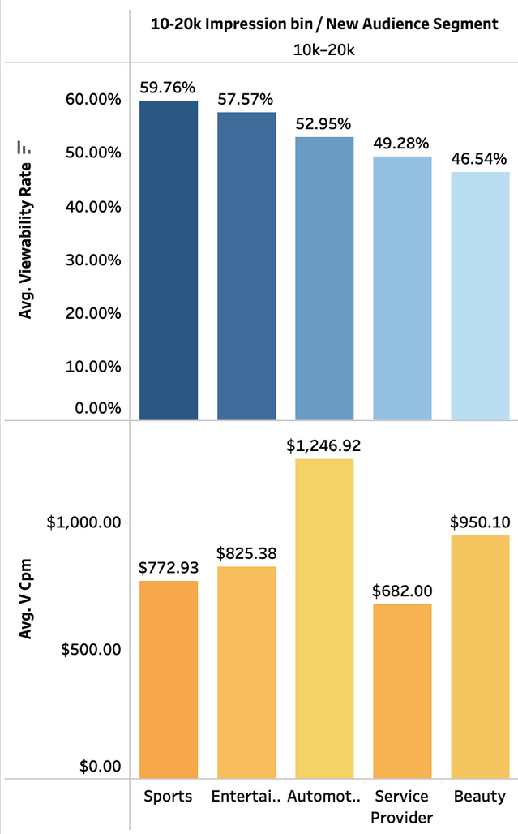
5k-10K Impressions
10k-20K Impressions
7

Slide 8
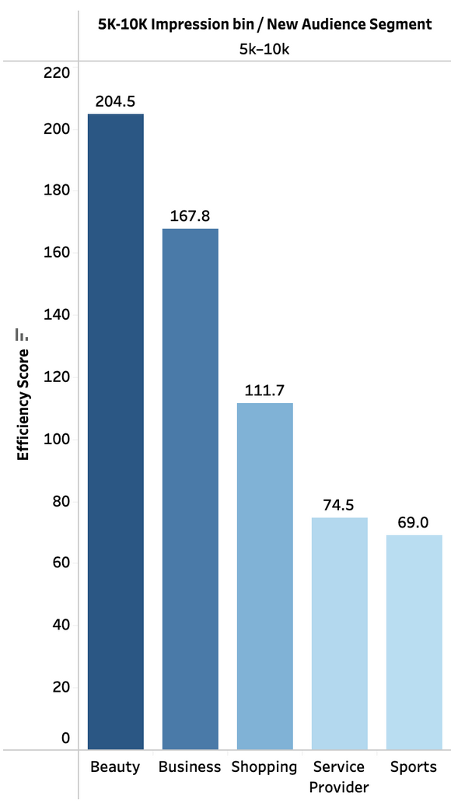
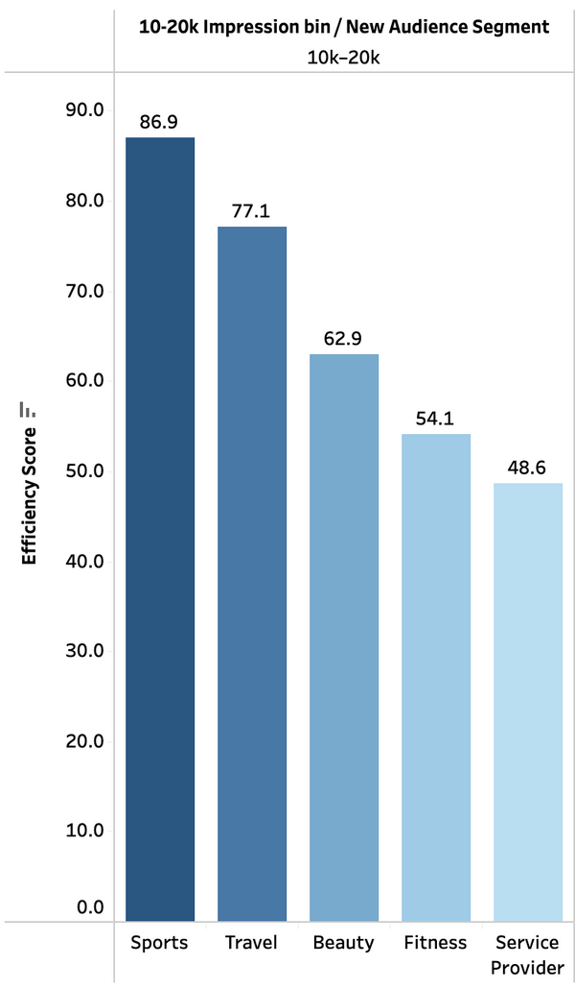
5k-10K Impressions
10k-20K Impressions
8

Slide 9
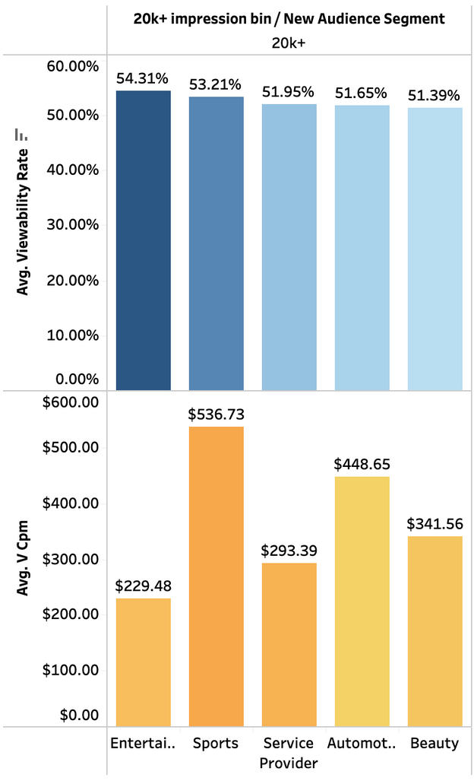
20K+ Impressions
Viewability rates remained consistent across high-volume segments.
vCPM varied significantly, with Sports being the most expensive.
High cost didn’t necessarily correlate with higher viewability.
9

Slide 10
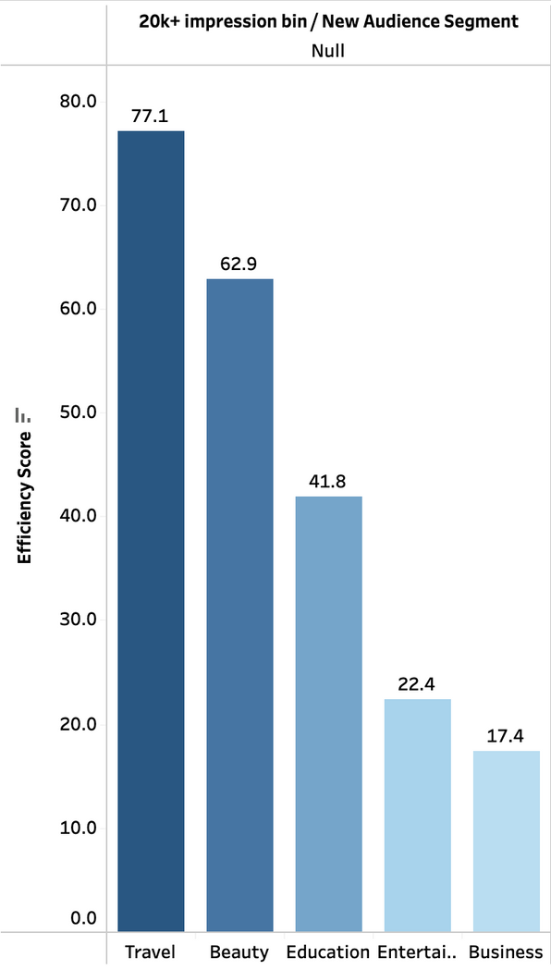
20K+ Impressions
Beauty audience segment is consistantly in top 3 for efficiency score.
Business and Entertainment had the lowest efficiency despite high impression volume.
Suggest prioritizing high-efficiency segments for future budget allocation.
10

Slide 11
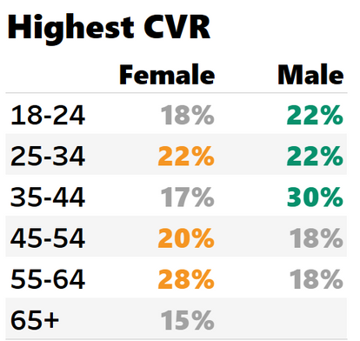
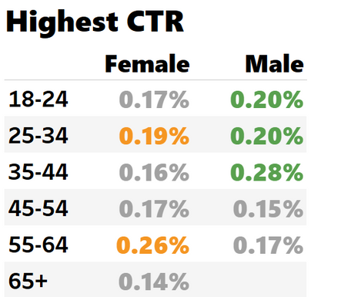
Top Conversion & Engaging Audience
Men aged 35-44: Our highest converters at 30%.
Women aged 55-64: Also show strong conversions at 28%.
The 25-34 age group performs well across genders at 22%.
Men aged 35-44: Lead engagement with a CTR of 0.28%.
Women aged 55-64: Also show strong click-through at 0.26%.
The 25-34 age group performs well across genders at 0.19% - 0.20%.
11

Slide 12
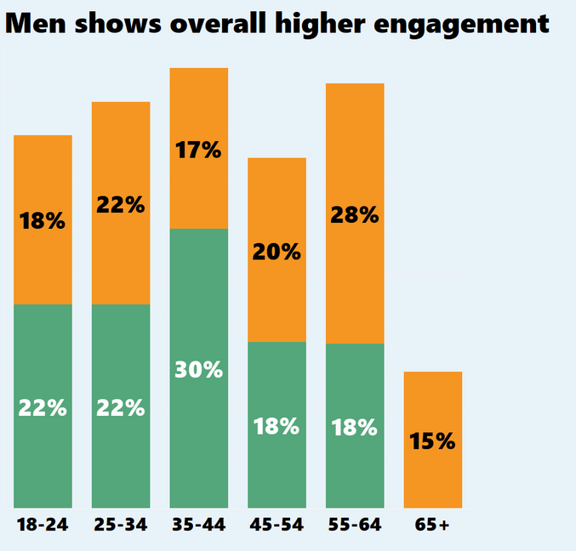
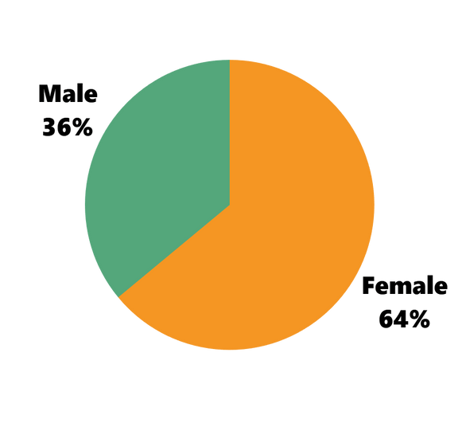
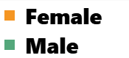
64% of our audience is female
36% of our audience is male
CVR
This shows that our top performing campaigns reaching more women than men.
Men show higher conversion rates in the 35-44 age group at 30%.
Females show higher conversion rates in the 55-64 age group at 28%.
12

Slide 13
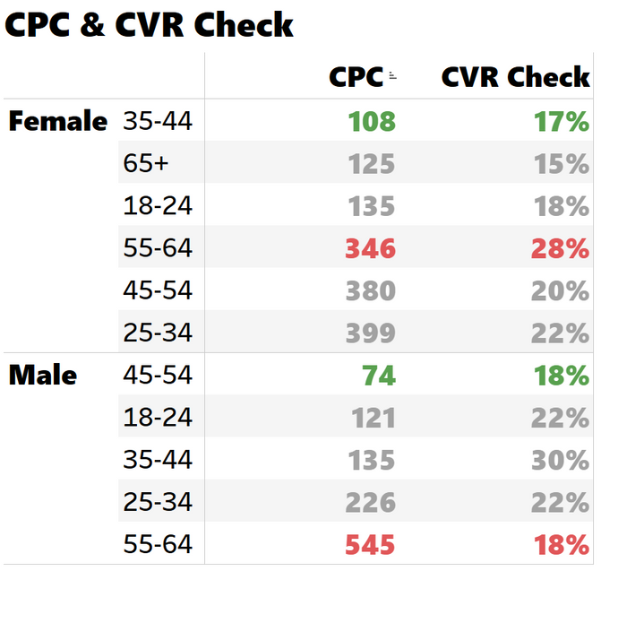
Are certain age brackets expensive but low-performing?
Female 35-44, Costs more per click
Lower performance
Higher performance, Costs more per click
Male 45-54, Costs less
Lower performance
Overall best performer: lowest cost
Highest Cost per click
CVR Check → how many users converted after seeing the ad
13

Slide 14
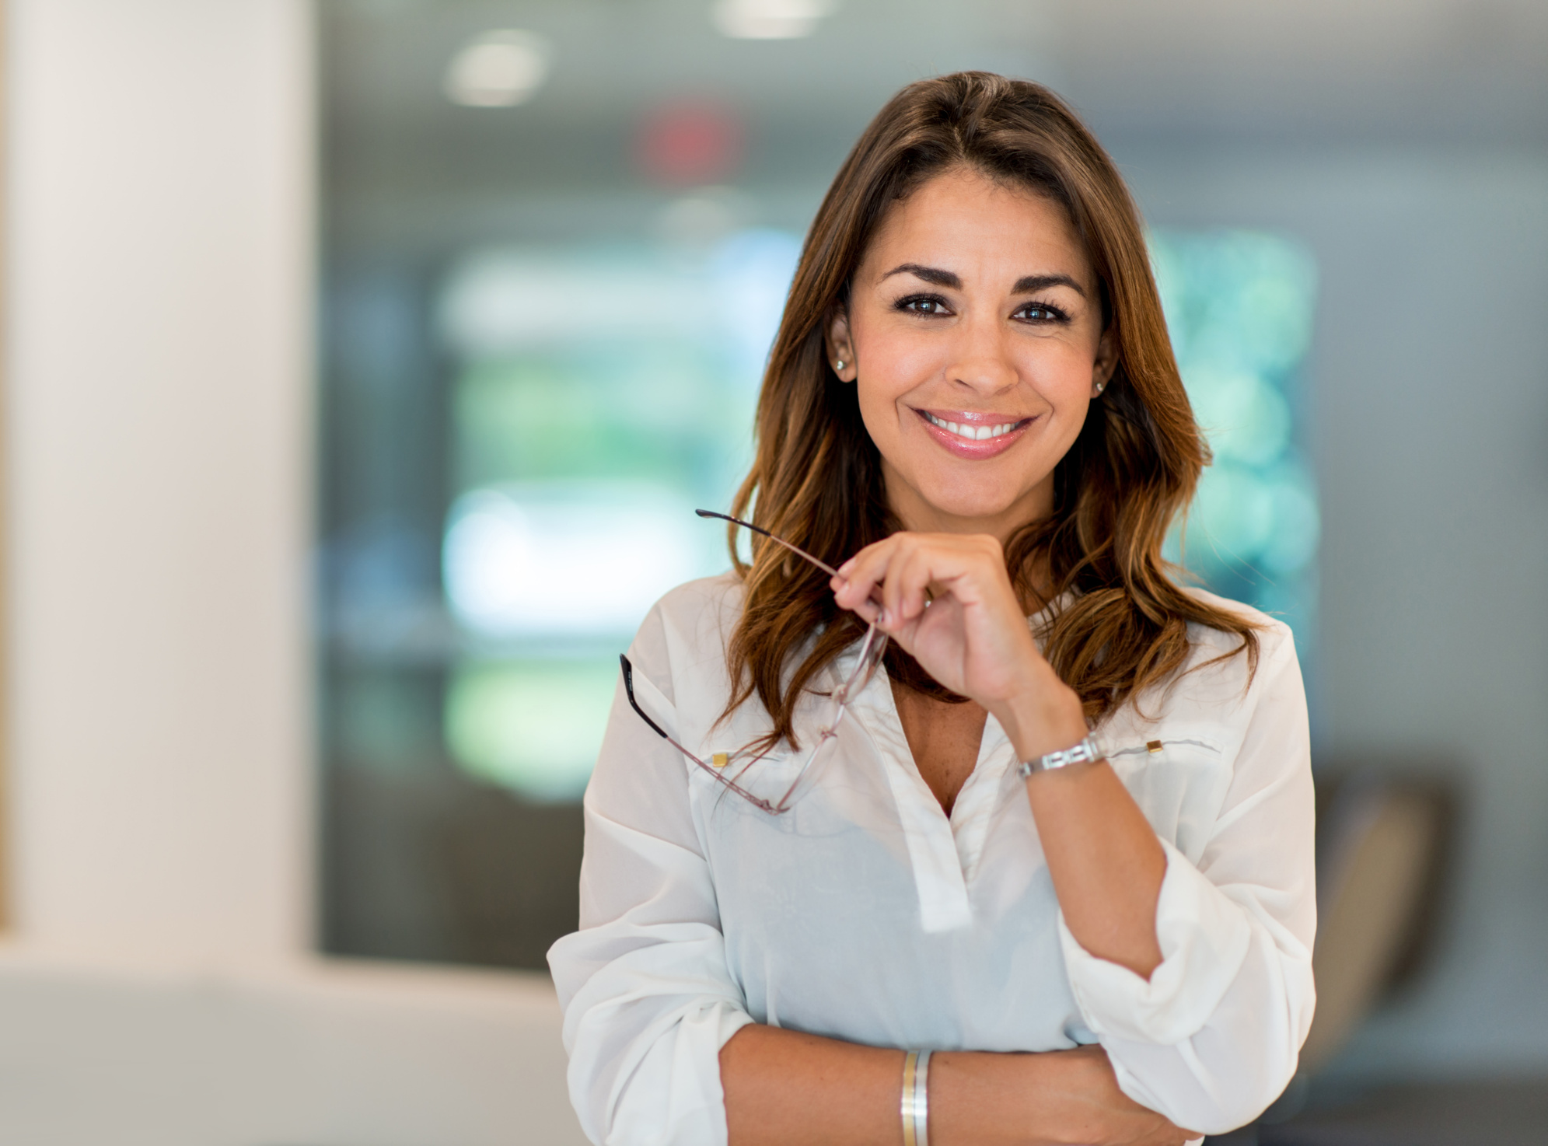



MOTIVATIONS
PAIN POINTS
She’s driven by a desire to look and feel her best at work and on weekends.
She loves discovering new “clean” brands through Instagram stories and peer recommendations.
Above all, she wants products that deliver visible results without irritating her sensitive skin.
Struggles to find the right products that are truly clean.
Feels pressured to stay on trend, but needs simplicity.
Feels overwhelmed by product overload.
GOALS
TECHNOLOGY
Streamline her routine with a 3–4 step regimen that minimizes fine lines and boosts radiance.
Invest wisely in products that offer multi-benefit formulations (hydration + anti-aging + SPF).
Stay on trend by trying the latest cruelty-free serums and sharing honest reviews with her online community.
SMART PHONE USER
SOFTWARE
SOPHIA
INTERNET
Planning Director, 28
Sophia is a college graduate from Florida
Cares using skincare that aligns with her values of cruelty-free and clean products
LOYAL
INTUITION
SMART
14

Slide 15
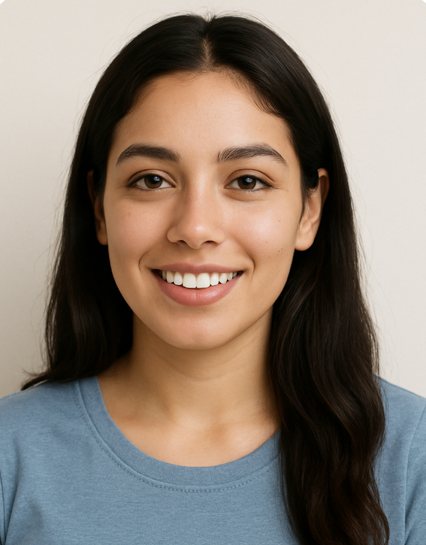

MOTIVATIONS
PAIN POINTS
Craves quick “glow-up” wins she can share in Stories.
She loves influencer-driven, viral “dupes” that promise luxe results on a budget.
Always seeks products with clean labels and peel-off packaging for the ‘unboxing’ moment.
There are too many launches, not enough clarity.
Pressure to keep up with trends.
Doesn’t know how to build on a routine.
GOALS
TECHNOLOGY
Build her collection of “Build her collection of “Instagrammable” skincare under $30.
Test & review 2–3 new launches each month.
Grow her following by posting honest mini-reviews.
Find cruelty-free favorites she can repurchase on a budget.
SMART PHONE USER
SOFTWARE
JADE
INTERNET
Social Media
Coordinator, 22
A college junior who devours TikTok beauty hacks.
FUN
OUTGOING
HAPPY
15

Slide 16
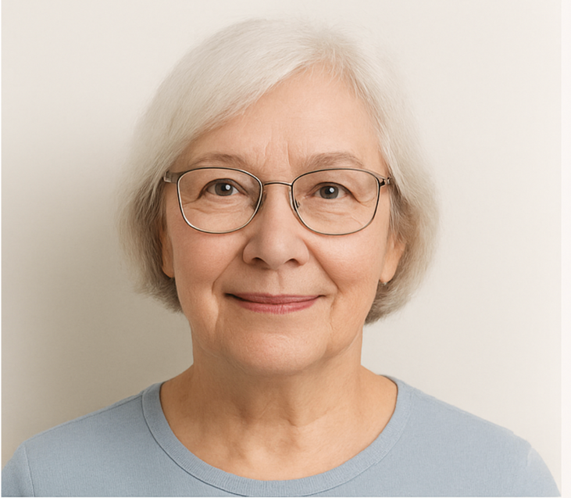



MOTIVATIONS
PAIN POINTS
Seeks ultra-mild formulas to calm thinning, sensitive skin.
Values heritage brands with long-standing reputations.
Loves botanical, spa-style experiences she can use at home.
Finds it difficult to idenitfy ultra-mild products, that don't cause irritation.
Feels overwhelmed by mainstream beauty ads, which cater to younger adults.
GOALS
TECHNOLOGY
Soothe dryness and loss of elasticity with rich, restorative creams.
Maintain radiance without harsh acids or perfumes.
Enjoy ritual—layering luxurious serums, masks, and balms.
Find trusted “legacy” brands offering senior discounts or bundles.
SMART PHONE USER
SOFTWARE
LINDA
INTERNET
Retiree & Yoga Instructor, 68
Health-focused grandmother. Prioritizes gentle, restorative care.
FREE-SPIRITED
KIND
CARING
16

Slide 17
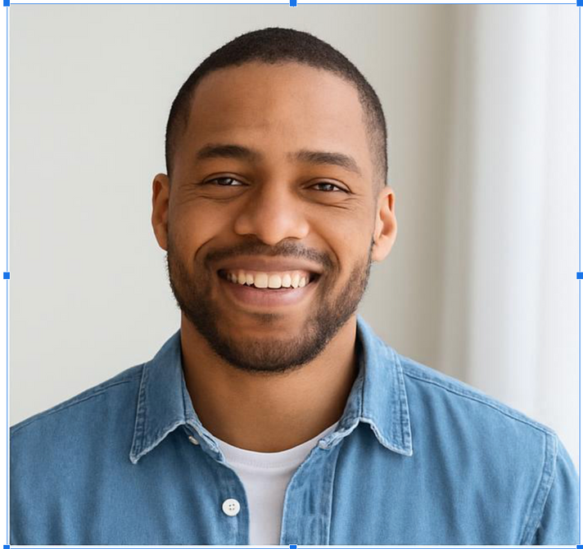



MOTIVATIONS
PAIN POINTS
Needs straightforward, no-nonsense products that fit into shared bathroom.
Wants quick absorption—no greasy residue when chasing kids.
Prefers clean-label, fragrance-free formulas that won’t irritate.
Overwhelmed by skincare jargon and product categories.
Hesitant to invest in full-size products without trail kits.
Has limited time and space to dedicate to personal care.
GOALS
TECHNOLOGY
Simplify down to 3 staples: cleanser, moisturizer with SPF, eye cream.
Learn basics via how-to guides (video or quick tips).
Balance price & performance—prefers mid-tier brands with travel-size kits.
Introduce wife/kids to his routine so products live on the countertop.
SMART PHONE USER
SOFTWARE
MICHAEL
INTERNET
Mechanical Engineer & Dad of Two, 38
Busy father. New to grooming but committed to self-care
PRACTICAL
RESPONSIBLE
EFFICIENT
17

Slide 18
Where Beauty Lives: Understanding Inventory Availability & Audience Reach
18
Notes:
In this section we will will be understanding the Inventory Availability and the Reach of the Audience

Slide 19
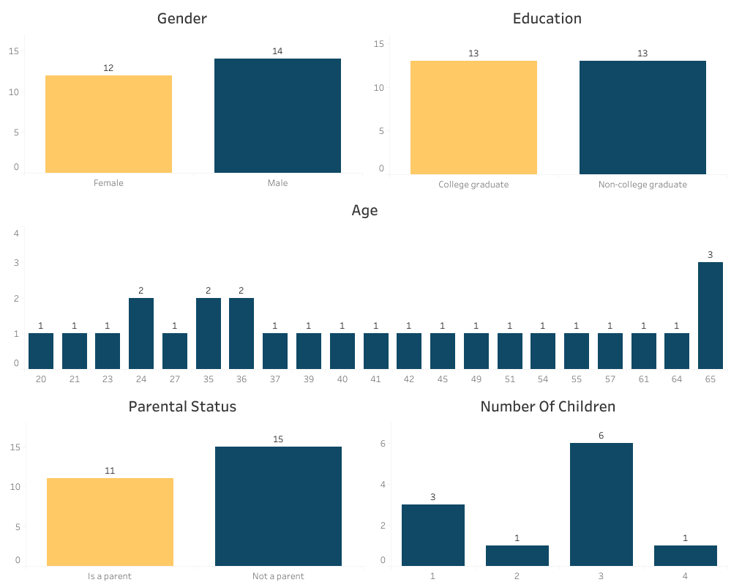
Audience Performance By Category
Men account for 53.8% of the Audience.
College Graduates and Non-college Graduates have an even number of representatives
The Most Popular Age is
Age 65 at 11.5%, followed by
Ages 24, 35, and 36 at 7.7%.
People without children account for 57.7% of the Audience.
The Most Popular number of Children is 3 at 54.5%.
19
Notes:
All the data is specific to the data related to beauty
This is the raw data of the Audience perfomance by Catagory
The sample size isnt large so there isnt a large variance between most of the catagories

Slide 20
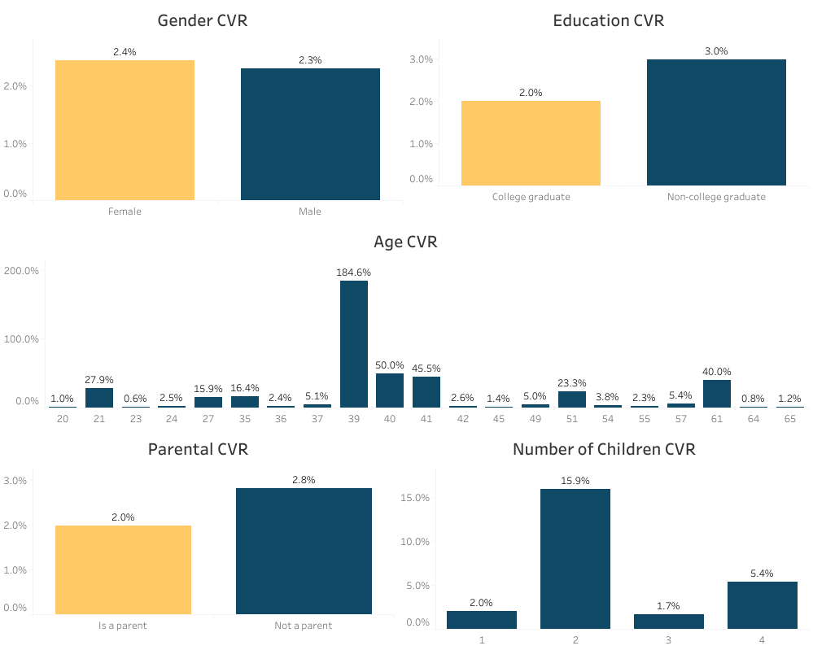
Conversion Rates Across Audience Segments
Women have a slightly higher conversion rate than men.
Non-college graduates have a 1% higher conversion rate than men.
The Top conversion rate per Age is
Age 39 by far, followed by Age 40, Age 41, and Age 61.
Non-Parents have almost a 1% higher conversion rate than Parents.
Parents of 2 kids have the highest conversion rate, followed by parents of 4 kids.
20
Notes:
The conversion rate of the ads show much more variance and give us an idea of specific catagories we can focus on
Some major targets would be non college grads, people with no kids and middle age people
Im going to pass it onto my fellow Audience Analyst Eunice

Slide 21
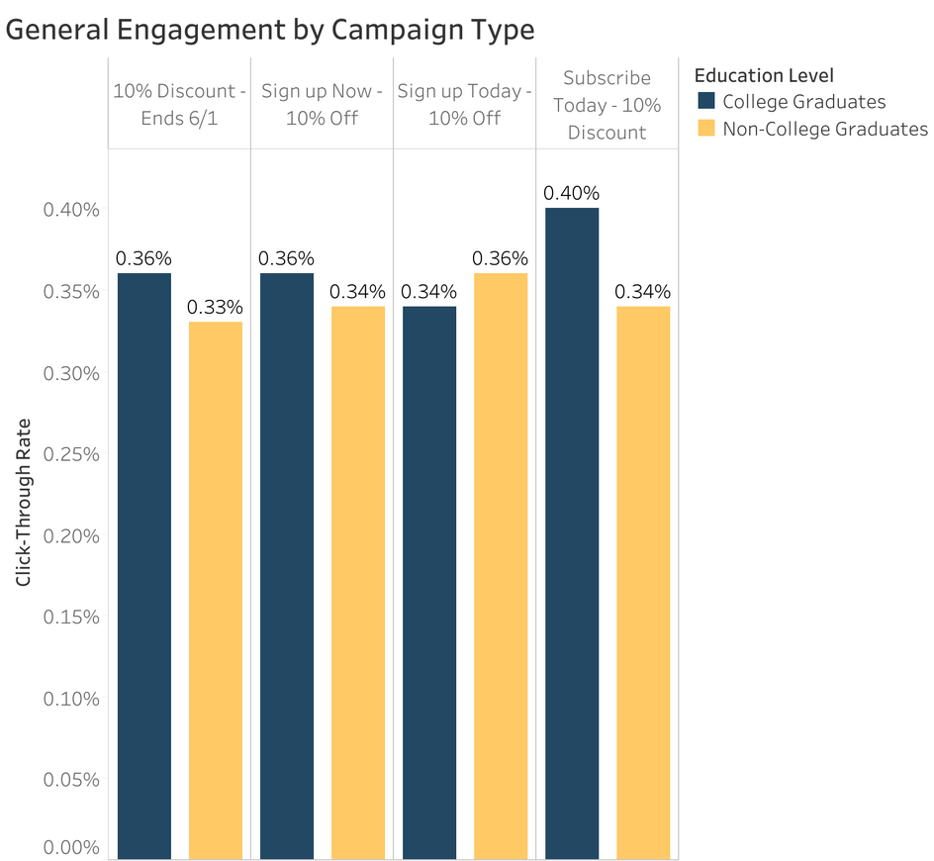
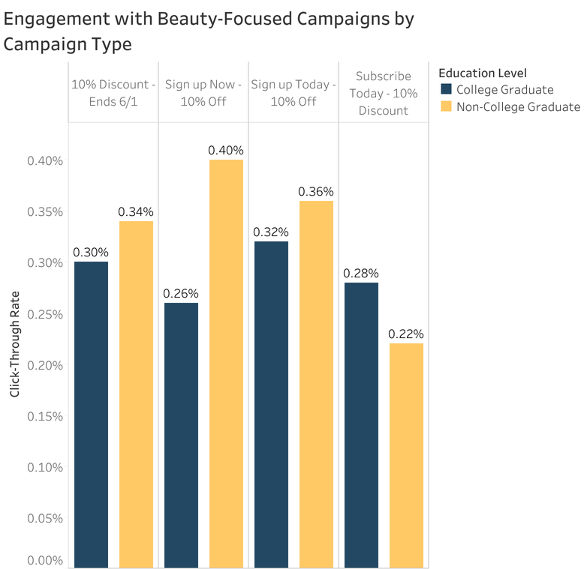
Click-Through Rates for Campaign Engagement by Level of Education
College graduates consistently had higher engagement (CTR) than Non-College graduates across all campaign types.
Non-College graduates showed relatively lower responsiveness to urgency-based messages.
“Subscribe Today - 10% Discount” campaigns had the highest engagement overall.
Non-College graduates engaged more with beauty-related campaigns overall.
The gap in engagement is most pronounced on urgent, discount-heavy messaging.
The only campaign that College graduates had stronger engagement with than Non-College graduates is “Subscribe Today - 10% Discount”.
21

Slide 22
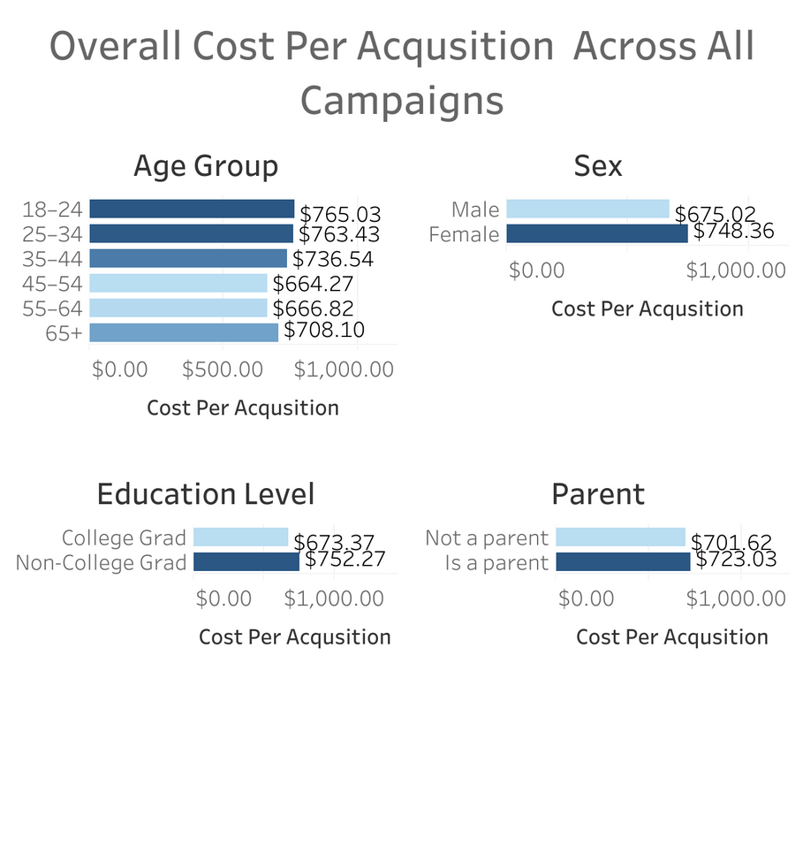
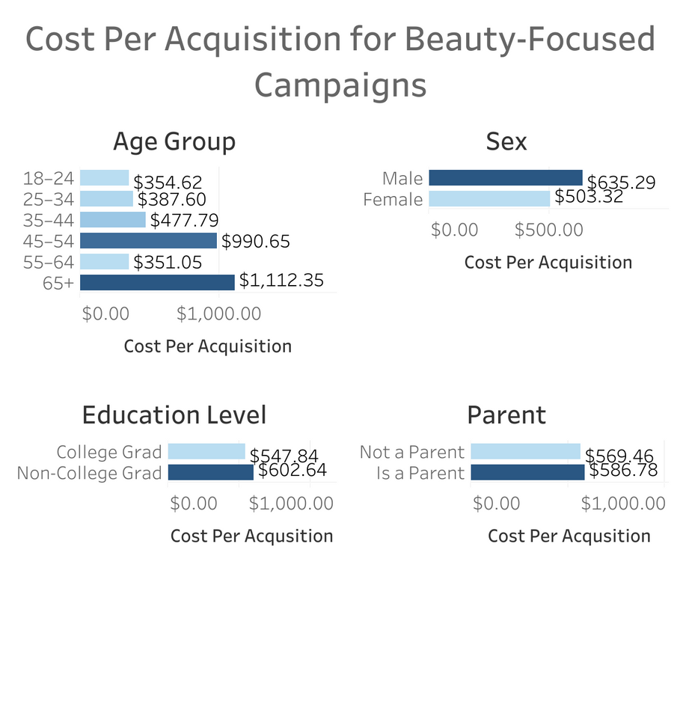
Cost-Effectiveness of Different Audience Groups by Campaign Type
Younger adults (18-44) were more expensive to acquire overall, whereas older adults (45-64) were more cost-effective.
Males are more cost-effective than females across all campaign types.
College graduates are more cost-effective than non-college graduates.
Non-parents are marginally more cost-effective than parents.
Beauty campaigns targeting early older adults (55-64) and younger adults (18-24) were most efficient.
Female audiences more cost-effective than male audiences.
College graduates more cost-effective than non-college graduates.
Non-parents marginally more cost-effective than parents.
22

Slide 23
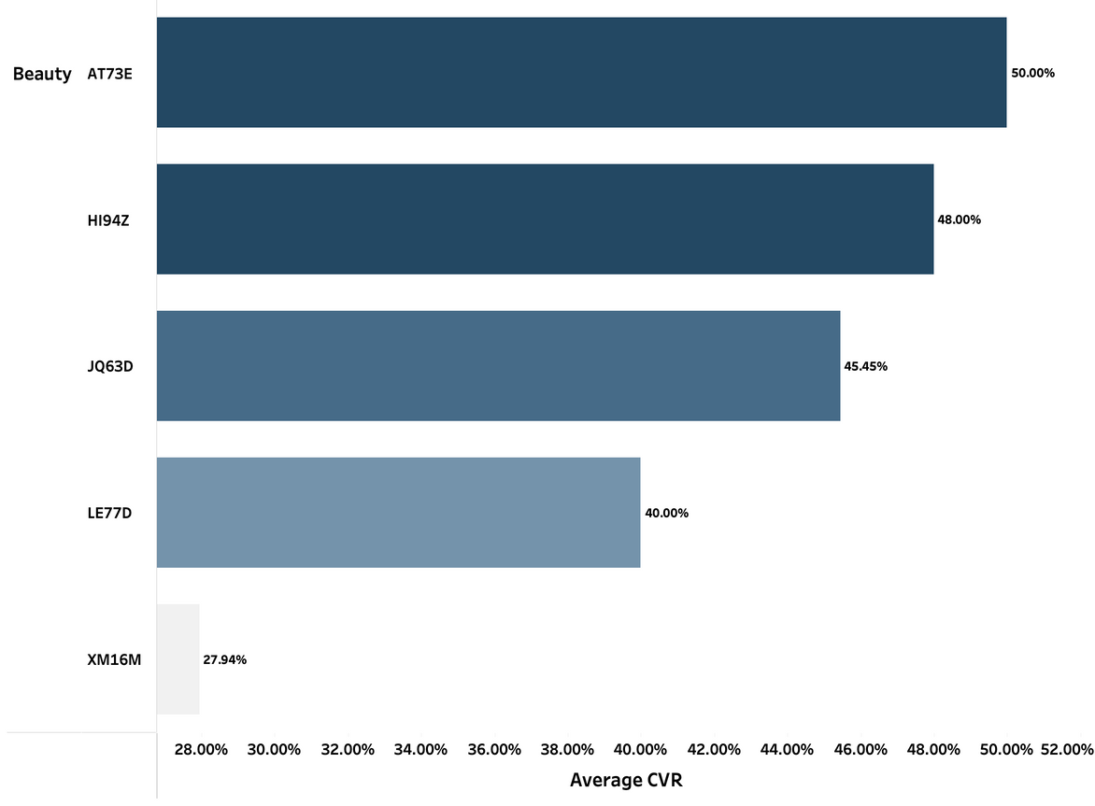
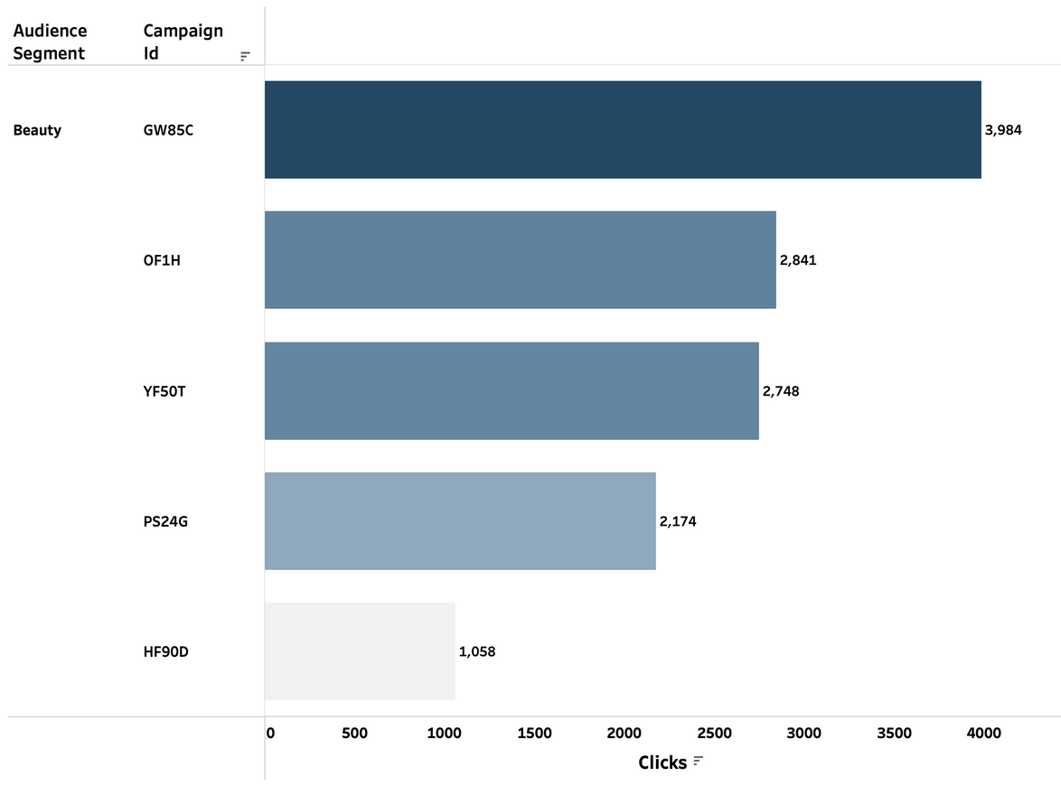
Top Five Beauty Campaigns by CVR and Clicks
CVRs ranged from 28% to 50%, well above typical industry benchmarks.
The top 3 campaigns converted nearly 1 in 2 clicks.
Strong conversion suggests aligned messaging and targeting.
Top campaigns received between 2,100 to nearly 4,000 clicks.
High click volume indicates strong ad appeal.
Not all high-click campaigns converted efficiently.
23

Slide 24
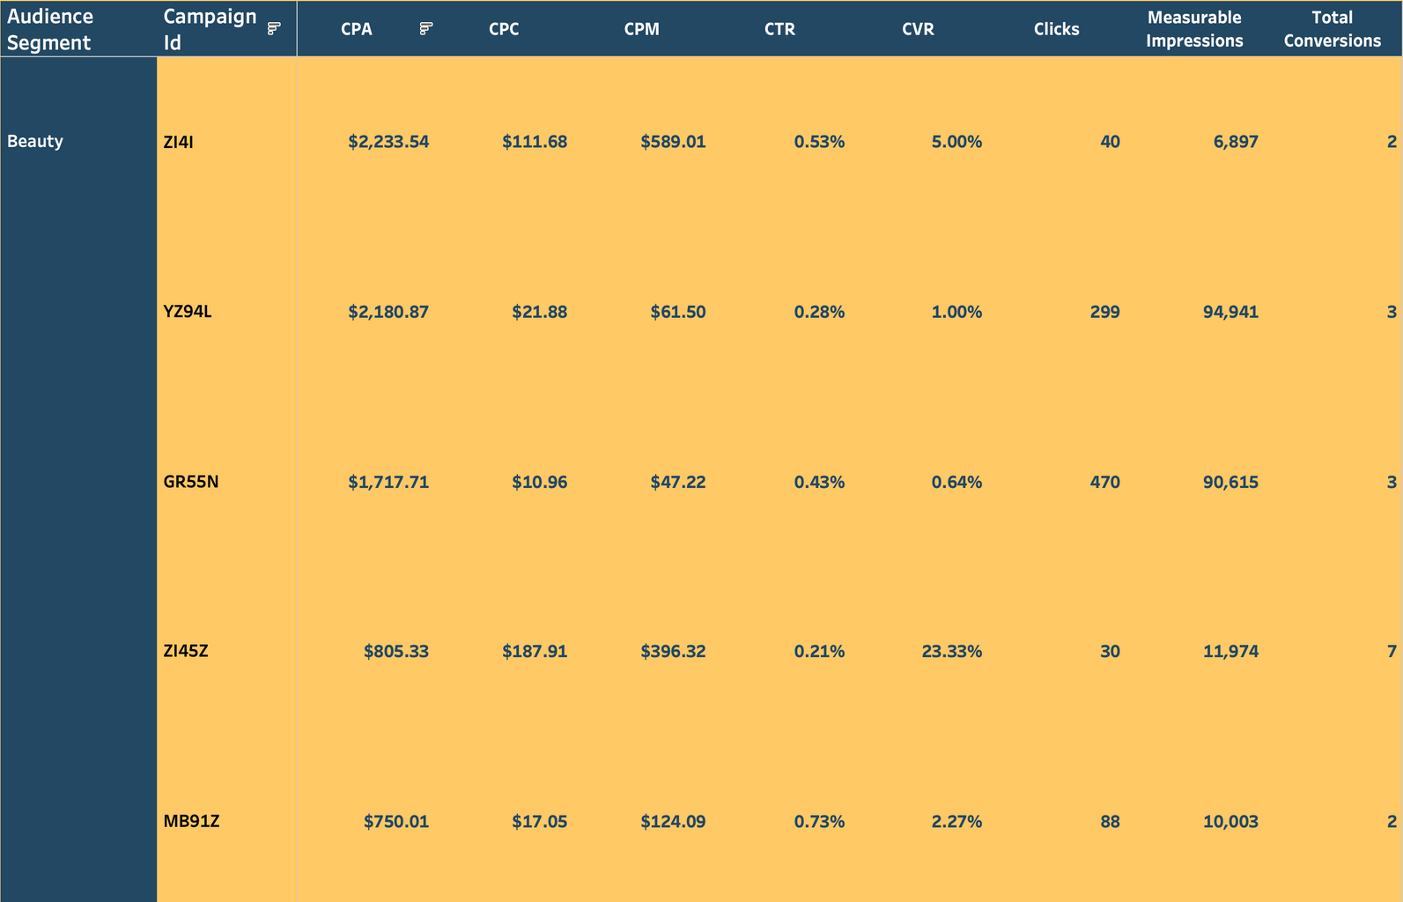
Campaign Metrics Table for Beauty
One campaign achieved a 23% CVR with a low CPA under $900.
Others with lower CVRs (1–5%) had much higher CPAs, some exceeding $2,000.
High cost doesn't always equal high performance.
24

Slide 25
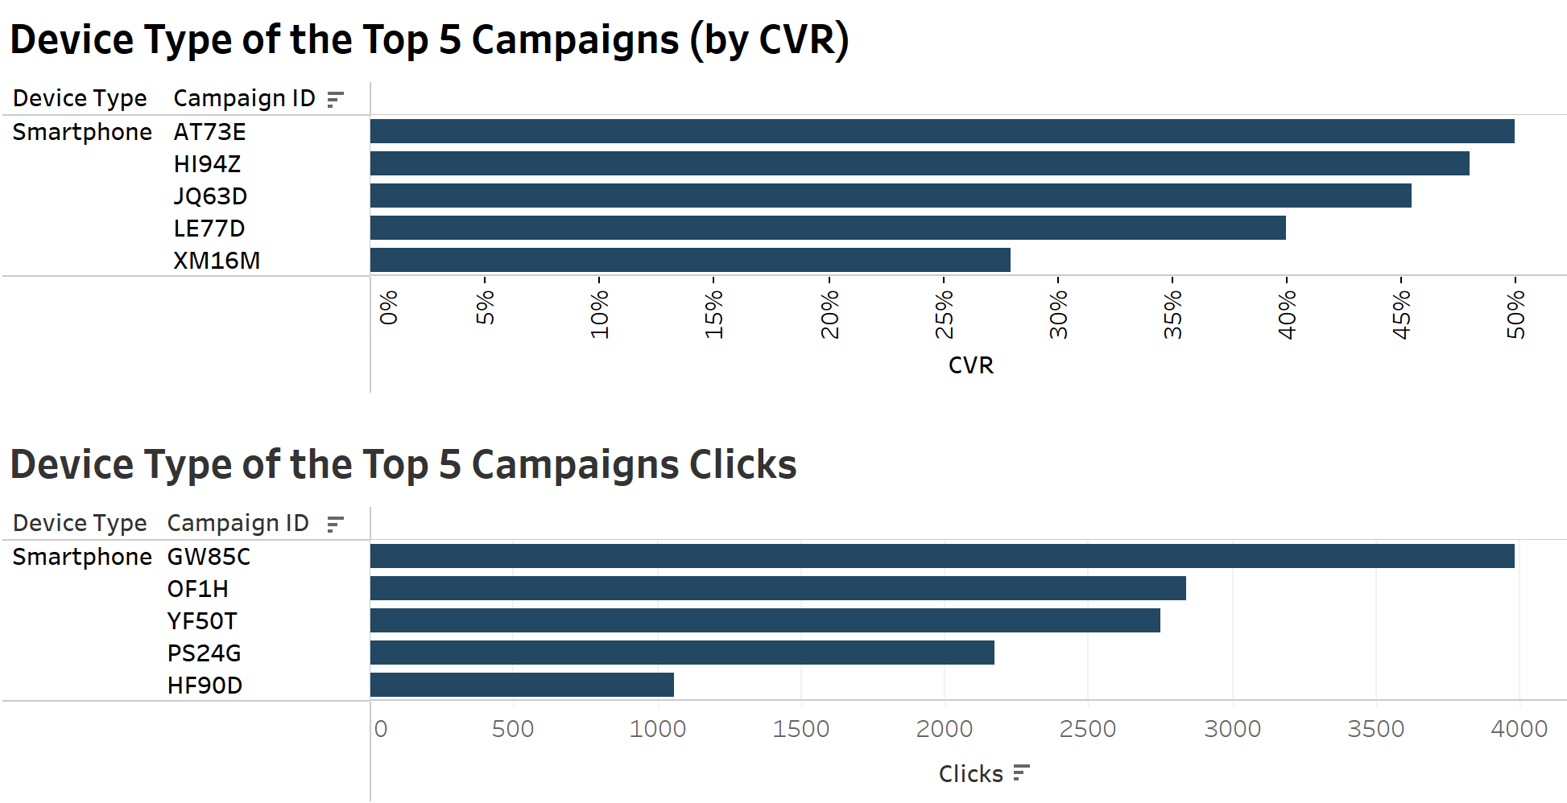
The top 5 campaigns in the Beauty industry have the Smartphone as their device type
25
Notes:
As Tenzin mentioned, these are the top 5 performing campaigns.
Lets expand on the top 5 performing campaigns. Specifically, the device types for each of these campaigns.
There are three types of devices: Apple PC, Smartphone, and Windows PC in this data.
As you can see, the top campaigns by conversion rates and clicks have the Smartphone as the device make.
These results clearly indicate that smartphone campaigns are leading both in terms of user engagement and actual conversions, making phones a key device type to focus on.
On the next slide we incorporate the factor of the Gross cost.

Slide 26
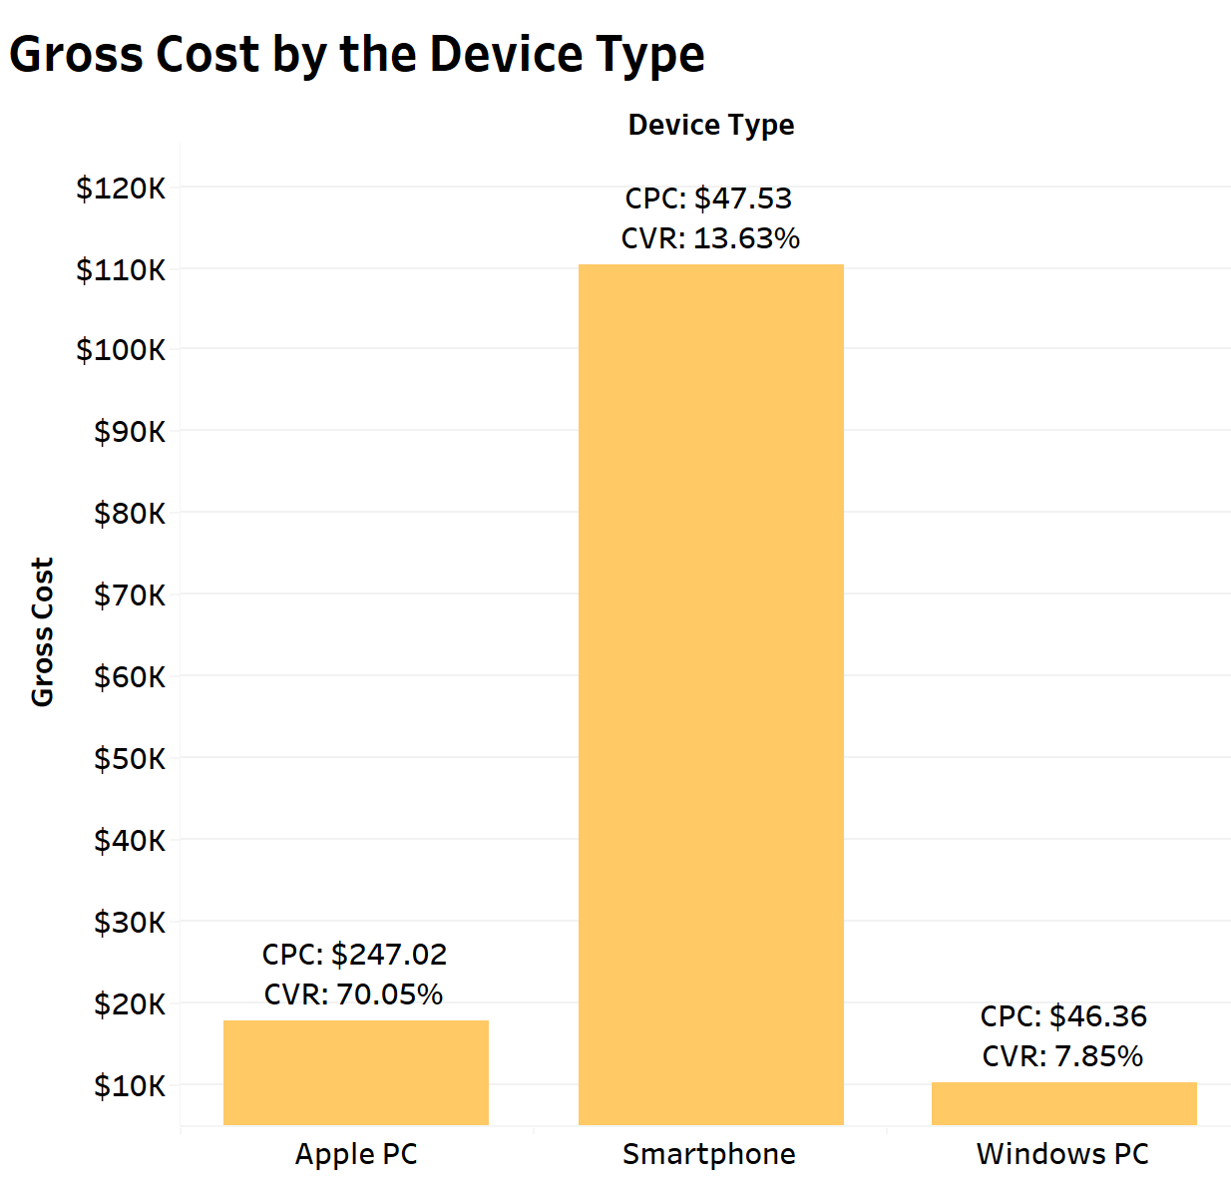
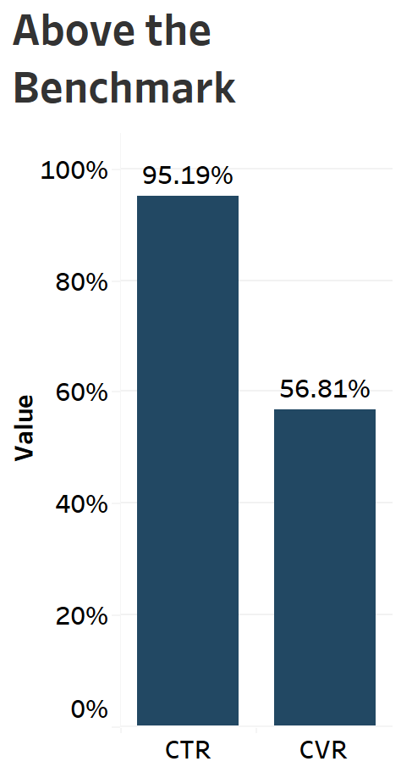
Industry
Benchmarks:
CTR: 1.51%
CVR: 5.2%
26
Notes:
Now we can see that the Apple PC has the highest conversion rate.
We found that Smartphones had the highest spend at around $110K, with a decent CVR of 13.63% and a CPC of $47.53.
While, Apple PCs showed the highest efficiency with a 70.05% CVR, though spend was lower—likely due to a high CPC of $247.02.
Windows PCs underperformed overall, with the lowest CVR (7.85%) and minimal spend.
This suggests that while smartphones capture the most traffic, Apple PCs might represent a high-quality, but expensive, audience. Meanwhile, Windows PCs may not be a priority for optimization.
Furthermore, our team of inventory analysts also decided to compare these metrics to industry benchmarks.
Our performance metrics demonstrate strong results, with CTR reaching an impressive 95.19% and CVR at a solid 56.81%, both indicating we are exceeding the industry benchmark.
As you can see, we are performing well above the benchmark in both areas, showing strong engagement and effective results.
On the next slide we have the key takeaways
DON'T READ ****Industry Benchmarks:
CTR: 1.51%
CVR: 5.2%
****** DONT READ From this we can recommend putting more costs towards marketing on both Apple PC's. This is because the conversion rate is the highest and have a higher chance of turning into profit.

Slide 27
Key Takewaways
1
Based on the audience and conversion data, we recommend focusing marketing efforts on women, non-college graduates, and non-parents, as each group shows slightly higher conversion rates. Special attention should be given to individuals aged 39–41 and 61, with age 39 performing best by far. Prioritizing these segments can help optimize engagement and improve overall conversion performance.
2
Based on this data, we recommend allocating more resources towards marketing on Apple PCs. This is because the conversion rate is the highest, and they have a higher chance of turning into profit. Focus optimization efforts on high-click, low-conversion campaigns to improve outcomes and reduce or reallocate spend from high-cost, low-performance campaigns.
27
Notes:
To summarize these findings it can be said that marketing efforts can focus on women, non-college graduates, and non-parents specifically individuals aged 39–41 and 61.
To further narrow down the scope, we can be focus on Apple PCs.

Slide 28
Beauty by Location: Understanding Where Consumers Engage Most
28

Slide 29
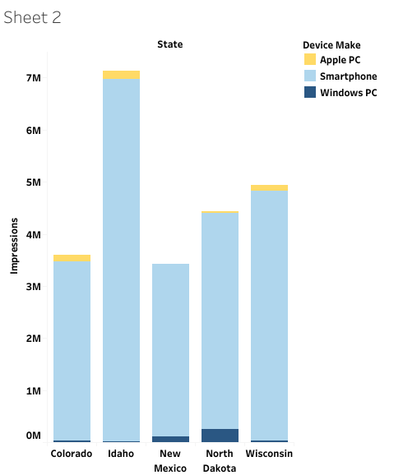
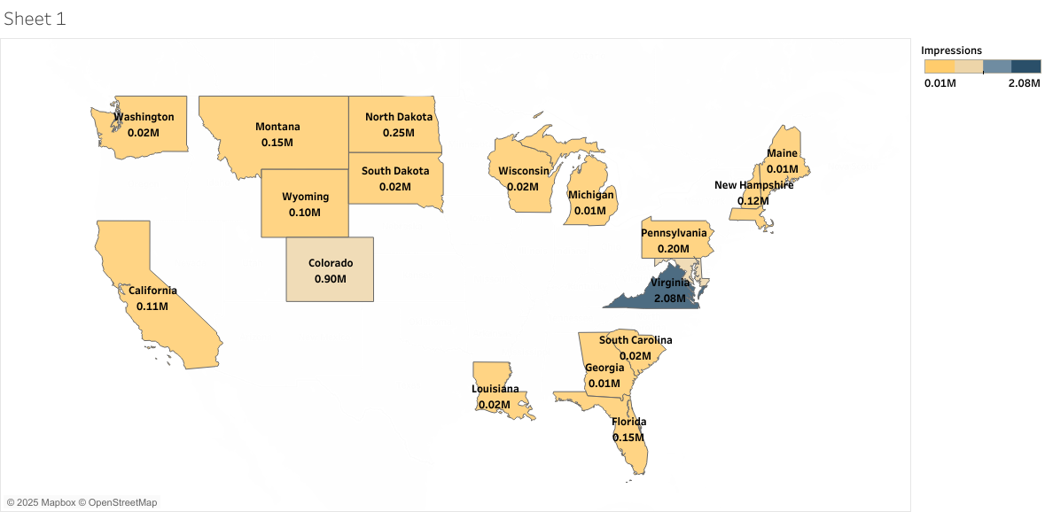
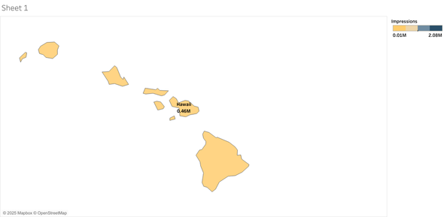
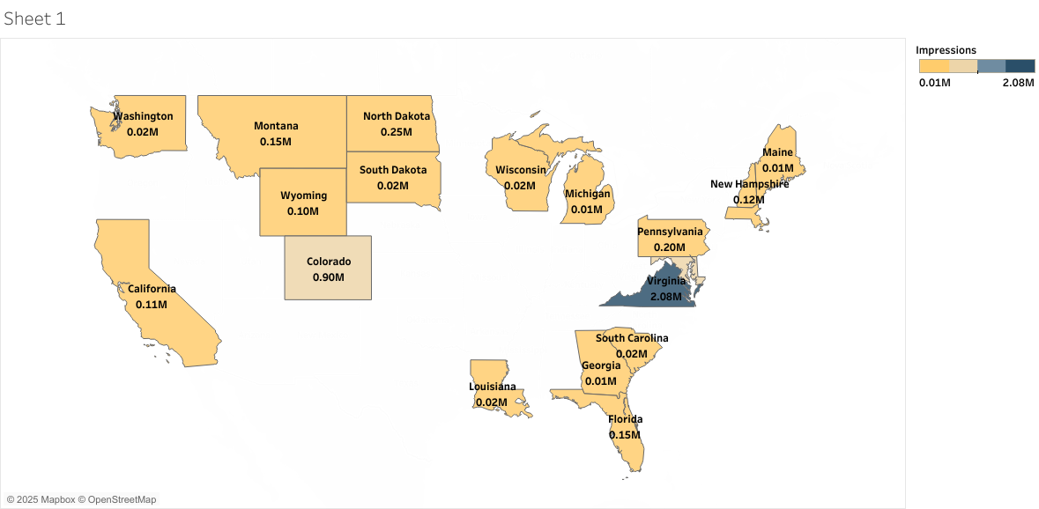
Impressions By Device
in the Top 5 States
Impressions By State
Massachusetts
0.02M
Maryland
0.73M
Hawaii
0.46M
Virginia, Maryland, and Colorado rank among the states with the highest total impressions, while Michigan, Maine and Georgia are among the lowest. Across device types in the top 5 performing states, smartphones are consistently ahead by at least three million.
29

Slide 30
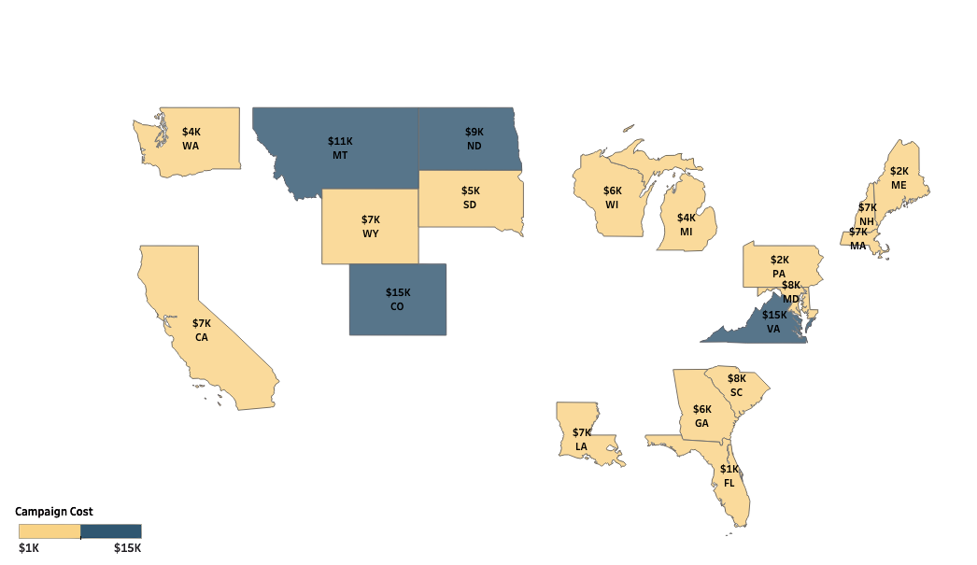
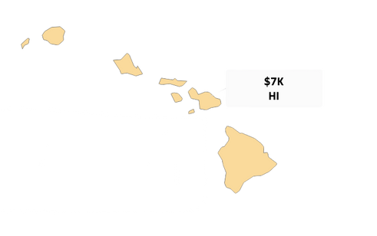
Campaigns Cost by State: Beauty
Highest Beauty Investments:
Colorado and Virginia - $15K ea.,
Montana - $11K
Mid-Tier Allocations:
North Dakota - $9K
South Carolina - $8K
California, Louisiana, Hawaii $7K ea..
Limited Pilot Tests:
Michigan - $4K
Pennsylvania - $2K
Florida - $1K
30

Slide 31


ROI* based on Cost Per Acquisition vs Conversion Volume
Colorado leads with the highest ROI* and conversion volume, showing strong campaign efficiency.
North Dakota and Maryland also perform well with solid ROI* and above-average conversion numbers.
Most Southern states, including Florida and South Carolina, show low ROI and minimal conversions.
Overall trend: The majority of states fall below average ROI*, highlighting limited effectiveness of beauty campaigns in many regions.
Top performers
CPA:231
Conversions: 66
ROI Score: 0.286
CPA: 199
Conversions: 47
ROI Score: 0.236
CPA: 218
Conversions: 37
ROI Score: 0.17
CPA: 136
Conversions: 11
ROI Score:0.08
*ROI Score = Total Conversions / CPA CPA = Dollars spent / Conversion
31
Notes:
CPA tells you spend efficiency (how many dollars each acquisition costs).
By dividing, you get “acquisitions per dollar‐per‐acquisition”, which—when compared across states—exposes where your budget buys the most conversions.
Unified Efficiency Score
A state with 300 conversions at $150 CPA → ROI Score = 300 ÷ 150 = 2.0
Another with 600 conversions at $400 CPA → ROI Score = 600 ÷ 400 = 1.5
→ Even though the second state delivered more total conversions (600 vs. 300), its lower ROI Score (1.5 vs. 2.0) flags it as less cost‐efficient.

Slide 32


National Campaign Performance by Conversion Rate
Top Performing States
Ohio - 10.87 %
North Carolina - 10.69%
Idaho – 9.81%
Arizona - 9.11%
Mississippi – 7.56%
These states are converting a higher percentage of viewers, which implies high-quality traffic or highly relevant campaigns/audiences.
32

Slide 33


Campaign Conversion Rate: Beauty
Texas recorded the highest CVR (11.94%) for Beauty campaigns, making it a key market where Beauty ads are resonating most effectively with the audience and leading to strong engagement and conversion efficiency.
North Dakota and Montana lead in total conversions for Beauty campaigns, with 62 and 60 conversions respectively, suggesting high user interaction volume in these regions potentially due to relevant targeting or campaign saturation.
33

Slide 34



Average Cost Per Acquisition for Beauty Ads Reveals Regional Disparities
Big Cost Gaps Across States: Ad costs range from $136 (Florida) to $2,234 (Michigan).
Higher Costs: States like Michigan, California, New Hampshire, Georgia, and Maine are the most expensive.
Lower Costs: Florida, North Dakota, Colorado, Maryland, and Washington offer more budget-friendly results.
Michigan Stands Out: Most Midwest states are mid-range, but Michigan’s high cost needs a closer look.
34
Notes:
In this part of the presentation, I looked at the Average Cost Per Acquisition — for beauty ads in 20 different U.S. states.
As you can see on the map, there’s a big range in costs. For example, in Florida, it costs about $136 to get one new customer, which is the lowest. But in Michigan, that cost jumps to over $2,234, which is the highest. Other higher-cost states include California, Georgia, and New Hampshire.
These differences might be caused by things like how competitive the market is, how many ads are running at once, or even how people shop in those areas. For instance, places like California and Michigan might be more expensive just because there’s more competition for people’s attention.

Slide 35


Higher Click Through Rates in New Hampshire and Michigan Suggest Strong Creative Performance
Highest engagement in New Hampshire and Michigan.
Northern states respond better to current creatives.
35
Notes:
Now, if we look at the next slide — this shows the Click-Through Rate which helps us understand whether the ad is catching people’s interest.
The top five states with the highest click rates are New Hampshire, Michigan, Virginia, South Dakota, and Hawaii. What’s interesting is that New Hampshire and Michigan show up in both slides — they’re expensive, but people in those states are also clicking on the ads more often.
which means even though it costs more to run ads in those states, they might be more effective if those clicks turn into customers. So, we can’t just look at cost — we also need to consider how people respond to the beauty ads.
In the future, it makes sense to study both cost and engagement together. States like Florida are great examples of where we’re getting good value, while places like New Hampshire show potential — as people are clearly interested, so we may just need to focus on turning those clicks into results.

Slide 36


Key Takewaways
1
Design and refocus campaigns primarily for mobile as its the most used device. Investigate low performing states such as Michigan, Maine, and Georgia in order to reduce investment in low profit markets.
2
Scale high-ROI markets and optimize before expanding.
3
Prioritize high-engagement Beauty markets, States like Texas and South Dakota show strong conversion efficiency, suggesting these regions are primed for scaling Beauty campaigns.
4
Improve targeting, messaging, and platform use to focus on high-cost areas like Michigan and California, and be customized to each state.
36
Notes:
To summarize our spatial analysis findings we’d like to address some key takeaways such as our goal to focus on mobile-first campaigns and reduce spending in low-performing states like Michigan, Maine, and Georgia.
and lastly, invest more in high-return states and optimize before expanding by tailoring campaigns.
Now I will go ahead and pass it on to Dimbe

Slide 37
Right Size, Right Message: Optimizing Creative Strategy in Beauty Advertising
37

Slide 38

AVERAGE CLICK THROUGH RATE BY CREATIVE SIZE
38

Slide 39

AVERAGE CONVERSION RATE BY CREATIVE SIZE
39

Slide 40

AVERAGE COST PER CLICK BY CREATIVE SIZE
40

Slide 41

CONVERSION RATE BY DEVICE TYPE
41

Slide 42

CONVERSION RATE BY SIZE 320X50
Performed best in North Dakota, Washington, and Massachusetts.
42

Slide 43

CONVERSION BY STATE SIZE 300X250
Performed best in Colorado
43

Slide 44

CONVERSION RATE BY STATE SIZE 300X50
Performd best in Wyoming
44

Slide 45


Device Engagement & Creative Messaging Impact
Over 80% of all viewable impressions came from Smartphones
meaning 80% of all the opportunities
it had a chance to be viewed
by a potential consumer came from smartphone users.
Smartphones account for 80.1% of CTR
showing that smartphones are a primary source
for user engagement in comparison to both
Apple and Windows PC’s.
45

Slide 46

Device Engagement & Creative Messaging Impact
Benefit and Urgency drives action:
almost 30% of CVR comes from messaging that offers clear benefit(getting 10% off)
46

Slide 47


Key Takewaways
1
With the majority of CTR and viewable impressions coming from smartphones, it is necessary to prioritize mobile optimization to ensure a positive user experience.
However, there are still consumers who utilize PC’s so there should still be an emphasis on pushing out ads that load faster as well as larger sizing to maximize reach
2
Messaging with value, benefit, and urgency drives higher conversion rates from consumers, so we recommend doubling down on this form of creative messaging.
47
Notes:
With most CTR and viewable impressions coming from smartphones, mobile optimization should be a top priority. However, since some users still rely on PCs, it's important to ensure fast-loading, large-format ads and focus on benefit-driven, urgent messaging to boost conversions.

Slide 48

Recommendations
We recommend prioritizing high-converting audience segments such as women, non-college graduates, and non-parents, with a particular focus on users aged 39 and 61. Additional resources should be allocated to Apple PC users due to their strong conversion rates. Efforts should also be made to optimize high-click, low-conversion campaigns and reduce spend on those with high costs and weak performance.
Language of the messaging used in campaigns/ads should be urgent and have an emphasis on immediacy and be discount-heavy to get higher engagement.
Reallocate the budget toward top-performing Beauty markets—such as Texas and South Dakota—while scaling back spending in high-cost, low-ROI states like California and Michigan to maximize overall campaign efficiency.
Use 300x250 ad creatives featuring urgency-driven messaging like “10% Discount – Ends 6/1,” as consumers are more likely to engage when there’s a clear deadline. Prioritize smartphone-optimized placements across high-traffic platforms such as Instagram Stories, YouTube Shorts, mobile web displays, and in-app environments (e.g., beauty or retail apps) to maximize visibility and conversion.
48
Notes:
Prioritize high-converting segments like women, non-college graduates, and non-parents allocate more to Apple PC users, optimize high-click/low-conversion campaigns, and cut spend on costly low-performers.
The Language of the messaging used in campaigns/ads should be urgent and have an emphasis on immediacy and be discount-heavy to get higher engagement.
Reallocate the budget toward top-performing Beauty markets such as Texas and South Dakota while scaling back spending in high-cost, low-ROI states like California and Michigan to maximize overall campaign efficiency.
Use 300x250 urgency-driven ads like “10% Discount – Ends 6/1,” optimized for smartphones and placed on high-traffic platforms such as Instagram Stories or YouTube Shorts to boost visibility and conversions.

Slide 49

Conclusion
The beauty industry presents a high-growth opportunity for advertisers aiming to reach engaged, brand-conscious consumers.
Aligning inventory strategy, geographic focus, and creative execution is critical to standing out in a competitive market.
Insights show that knowing where, who, and how to reach beauty consumers drives stronger campaign performance.
By connecting audience insights, location strategy, and optimized messaging, global agencies can boost engagement and long-term revenue.
49
Notes:
Success in the beauty space comes down to knowing the right audience, markets, and messaging. Agencies can boost engagement, optimize spending, and drive stronger results with a targeted and data-driven approach. By following our targeted recommendations, the agency is positioned to improve campaign efficiency and engagement—projecting up to a 30% increase in advertising success within the beauty industry by 2027.

Slide 50

Thank You
Please reach out if you have any questions !!
50

